Slide 1

Track Module 2 Transfer Learning
Ekaterina Golubeva
30.03.2023

Slide 2
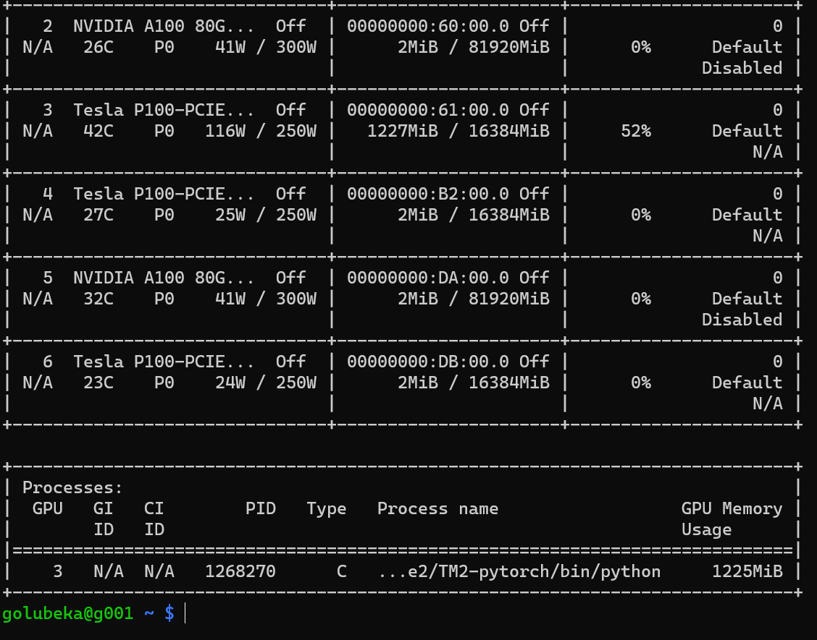
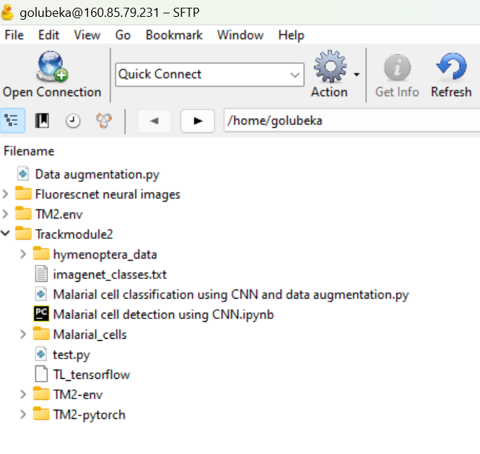

Set up

Slide 3
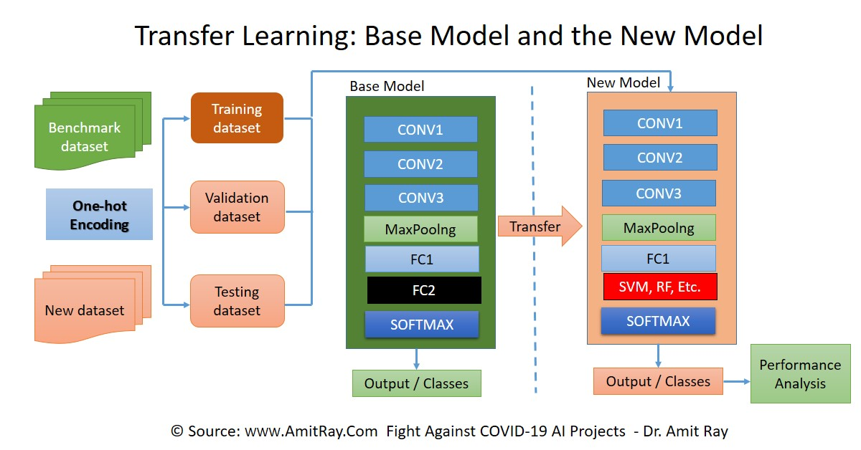

Slide 4
Two major transfer learning scenarios
Finetuning the CNN
Instead of random initialization, we initialize the network with a pretrained network, like the one that is trained on ImagenNet 1000 dataset. Rest of the training looks as usual.
CNN as fixed feature extractor
Here, we will freeze the weights for all of the network except that of the final fully connected layer. This last fully connected layer is replaced with a new one with random weights and only this layer is trained.

Slide 5
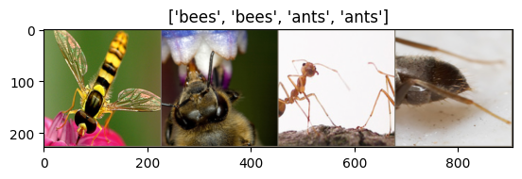
PyTorch Transfer learning tutorial
Classifying images of bees and ants

Slide 6
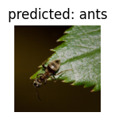
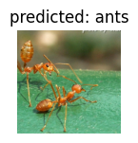
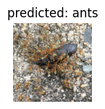
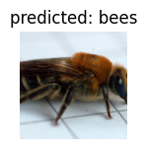
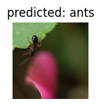
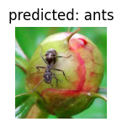
Finetuning the CNN
Training complete in 1m 5s
Best val Acc: 0.934641

Slide 7
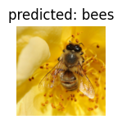
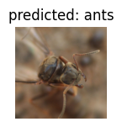
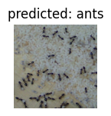
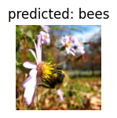
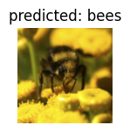
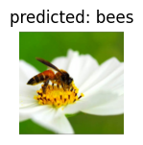
CNN as fixed feature extractor
Here, we need to freeze all the network except the final layer. We need to set requires_grad = False to freeze the parameters so that the gradients are not computed in backward().
Training complete in 0m 40s
Best val Acc: 0.960784

Slide 8
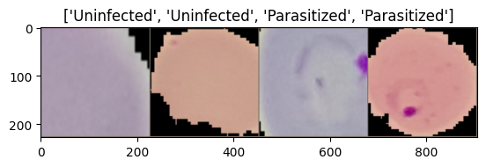
Applied to the Malarial cells problem
Model : ResNet16
Batch size : 4
Epochs : 25
Learning rate : 0.001

Slide 9
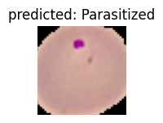
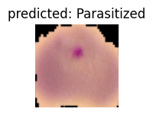
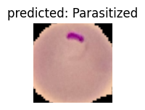
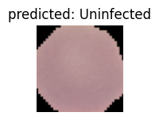
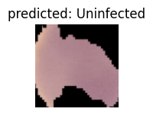
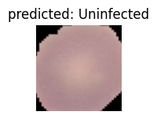
Finetuning CNN
Training complete in 58m 43s
Best val Acc: 0.850000

Slide 10
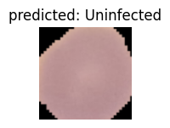
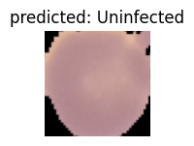
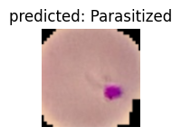
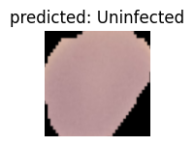
CNN as fixed feature extractor
Training complete in 16m 15s
Best val Acc: 0.900000
(Changed number of epochs to 20, batch size = 4)

Slide 11
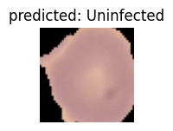
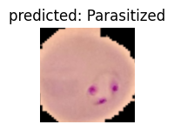
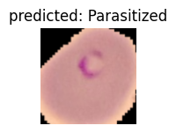
Same exercise with different parameters
Model : ResNet18
Batch size : 32
Epochs : 15
Learning rate : 0.01
Training complete in 6m 21s
Best val Acc: 0.900000

Slide 12
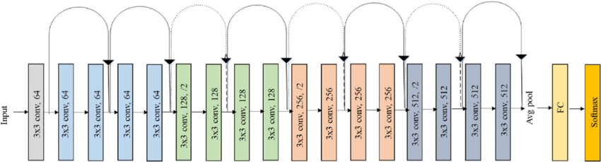
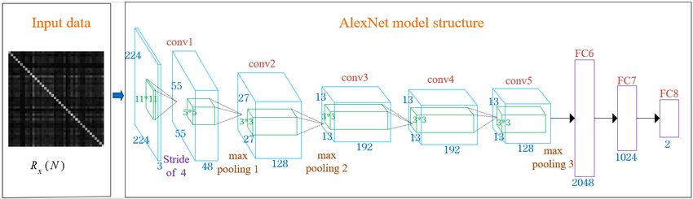
ResNet18 AlexNet

Slide 13
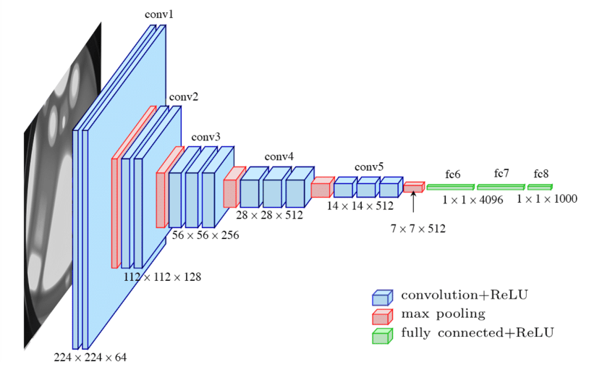
VGG16

Slide 14

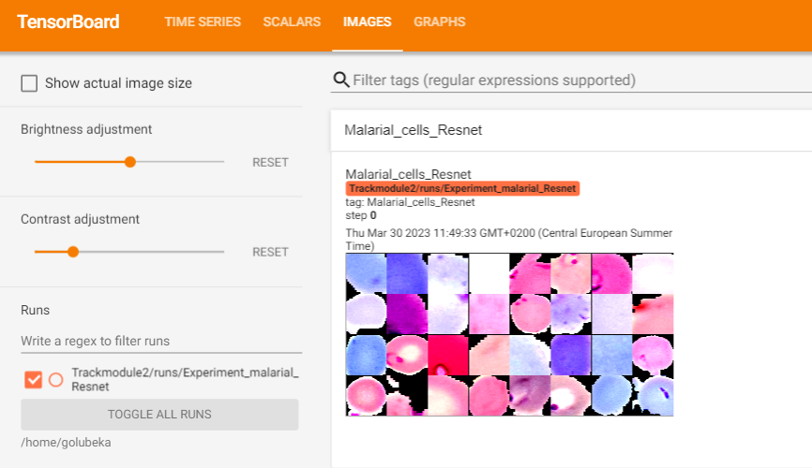
Visualizing images

Slide 15
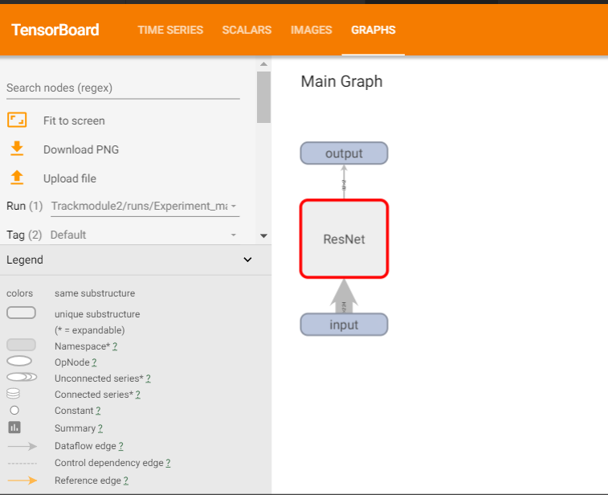
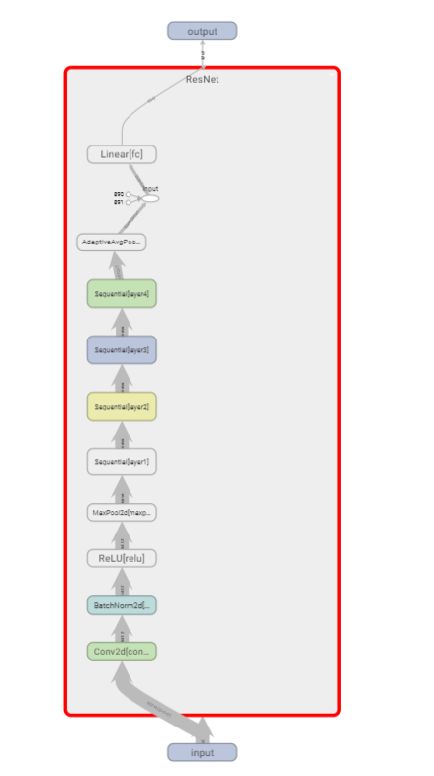
Visualizing graphs : the model architecture

Slide 16
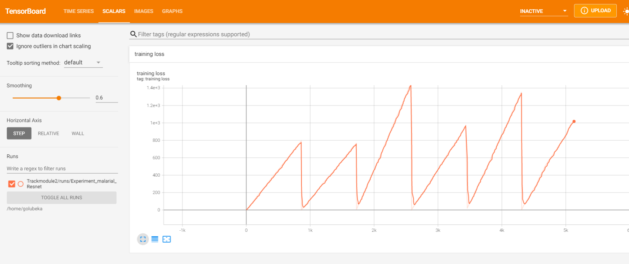
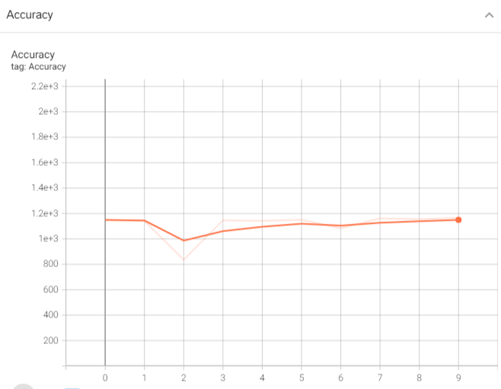
Visualizing scalars : model performance

Slide 17
Next steps : Use Tensorboard to log and compare learning curves
Experiment 1 : Compare ResNet18 vs VGG16 vs AlexNet accuracy and running time (starting with random weights, pretrained = False)
Experiment 2 : Compare learning rates’ influence on the performance ( fixed vs plateau vs exponential scheduler )
Experiment 3 : Compare batch size’s influence on the performance

